Slide 1

MACHINE
INTELLIGENCE
Kernel
K.S.Srinivas
Department of Computer Science and Engineering

Slide 2

MACHINE INTELLIGENCE
Kernel
K.S.Srinivas
Department of Computer Science and Engineering

Slide 3
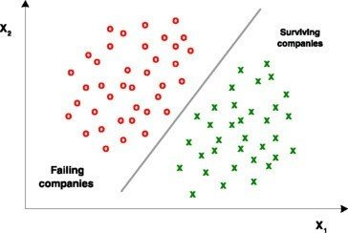
MACHINE INTELLIGENCE
Support Vector Machine
This is one of the most sophisticated yet simple to implement to algorithms.
Support Vector Machines is largely thought of as a linear classifier.
Certain myths about SVMs
Linear Classifier -> Nope it can handle non-linearity as well
Single linear Classifier -> We would do multi – classification
Classifier-> It can do regression as well
SVM are computationally expensive -> with the right C and γ they work like charm
Not a myth – Math heavy and fundamentally provable
A data set is said to be linearly separable if we can have a hyper plane that cans separate them.

Slide 4
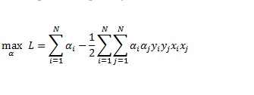

MACHINE INTELLIGENCE
Some basic Formulation
Subject to
The beauty of the algorithm.
Only Scalar quantities except for x_{i}.x_{j}
Would be computationally inexpensive if all wee had to was just a dot product of TWO VECTORS

Slide 5
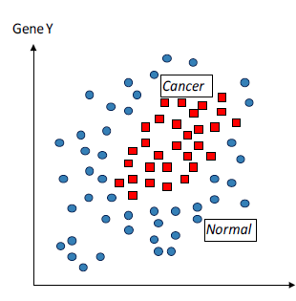
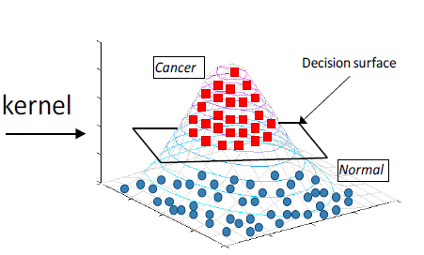
MACHINE INTELLIGENCE
Non Linearity
How do we separate such data ?
Maybe by adding another dimension.
One more dimension – Yup.
But which Dimension
How many dimensions
More dimensions means more computation
Real Life data has 1000 dimensions and for separation we may need to scale by 1000.

Slide 6
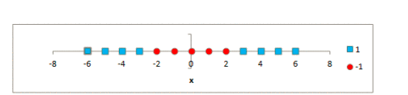
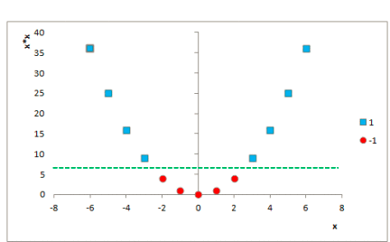
MACHINE INTELLIGENCE
Finding dimensions
That does not seem to be separable given only 1d.
What if we converted this to a 2 feature vector z = [ x, x*x]
Clearly Separable
Given this can find a set of dimensions to separate out this data

Slide 7
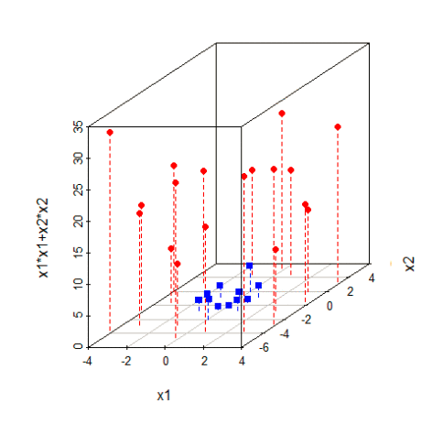
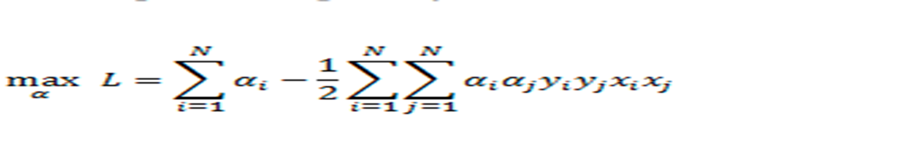


MACHINE INTELLIGENCE
The transformation trick
Sure, but is that computationally expensive
Not Really , With a new trick in our tool bag called as the kernel trick.
Recollect that
Which has just a dot product
ϕ is the symbol we using for feature engineering

Slide 8
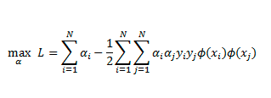
MACHINE INTELLIGENCE
Modified Dual Form
So the new dual is a kernel function applied on the dot product terms
This would mean going to those higher dimensions and then computing the dot product
Not really – Lets see this with an example

Slide 9

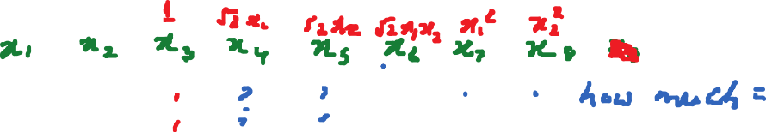
MACHINE INTELLIGENCE
Example
Dot These
Now compute (a.b+1)²
Both have the same value.
That’s the neat trick. We can compute the value by one dot + some constant squared

Slide 10
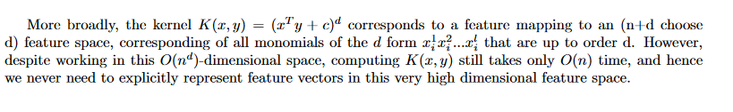
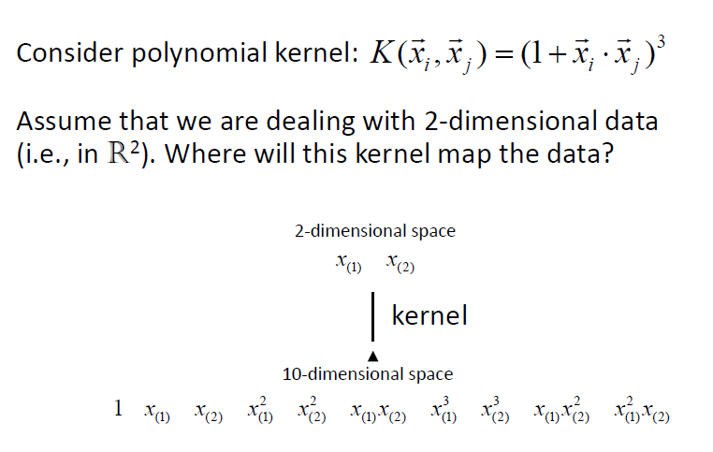
MACHINE INTELLIGENCE
Polynomial Kernel
The trick we used in the earlier example is a polynomial kernel

Slide 11
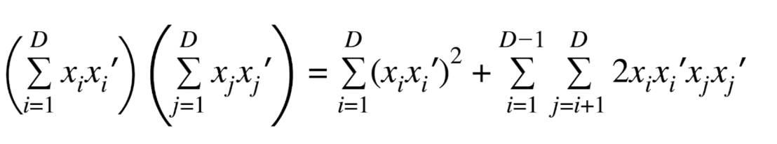
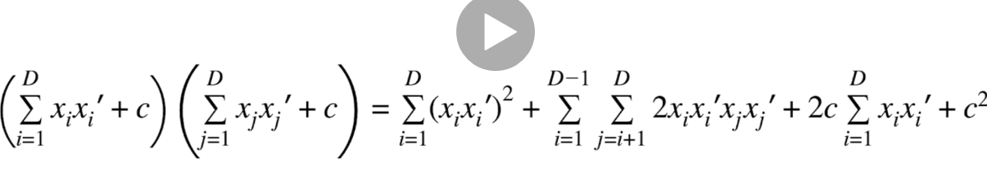
MACHINE INTELLIGENCE
Polynomial Kernel Expansion for d=2

Slide 12



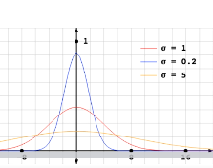
MACHINE INTELLIGENCE
Gaussian Kernel
This is the most popular kernel
Synonymous with SVM and the default
This has the same shape as a Gaussian , but is not a PDF since it is not normalized
High Variance – Low precision
Low Variance – High Precision

Slide 13
MACHINE INTELLIGENCE
Behaviour of Gaussian Kernel
Measures the similarity between x and x’.
Recollect
If x and x’ are similar we get exp(0)
If x and x’ are different we get values from 0 to < 1.
The further the points are exp gets smaller.
But the key point is that it only depends on the radial distance between the 2 and is independent of relative position
Hence the name radial basis function

Slide 14
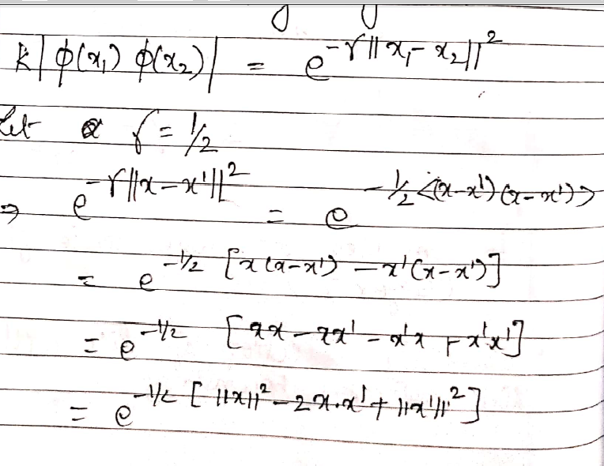
MACHINE INTELLIGENCE
Beauty of Gaussian Kernel
For any kernel to be valid it must be expressed in terms of a dot

Slide 15
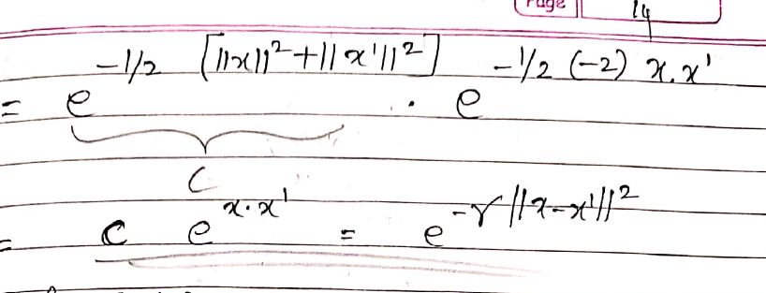
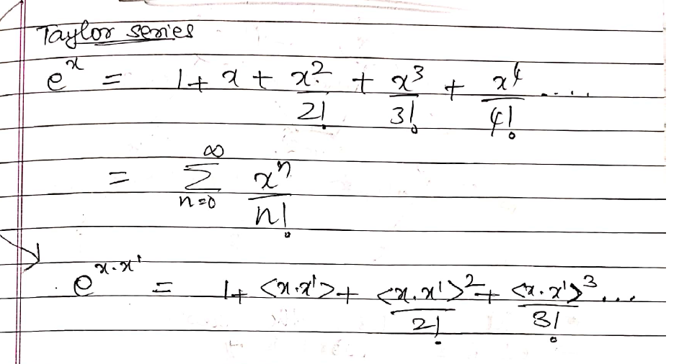
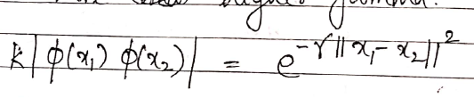
MACHINE INTELLIGENCE
RBF
You can see that this takes you to infinite dimensions

Slide 16
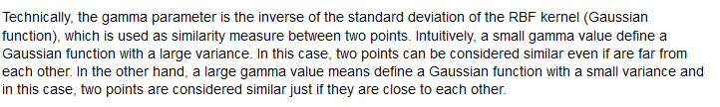
MACHINE INTELLIGENCE
Effect of Gamma

Slide 17
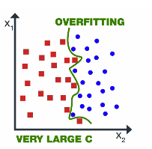

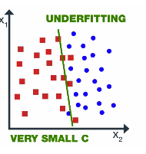
MACHINE INTELLIGENCE
Intuition behind C and Gamma

Slide 18
THANK YOU
K.S.Srinivas
srinivasks@pes.edu
+91 80 2672 1983 Extn 701

